Slide 1






MGMT 6056 Module 5
Exercises
Do the exercise prior to next slide
Videos
Solution Slide
Creating a Project Budget
PPT Animations
Exercise Simulation
See text in “slide note” for more details
Assignment Estimates & Time Phased EXAMPLE V1.xlsx
Assignment Estimates & Time Phased Student TEMPLATE V1.xlsx

Slide 2
Module Learning Objectives
Understand and discern the differences of the following budgeting approaches:
Top-Down Budgeting
Bottom Up Budgeting
A Hybrid: Phase Estimating
Perform calculations for Activity-Based Costing (ABC)
Understand a Time Phased Budget and how to complete one using Excel
Understand different contract types
Work with basic costs in different contract types

Slide 3
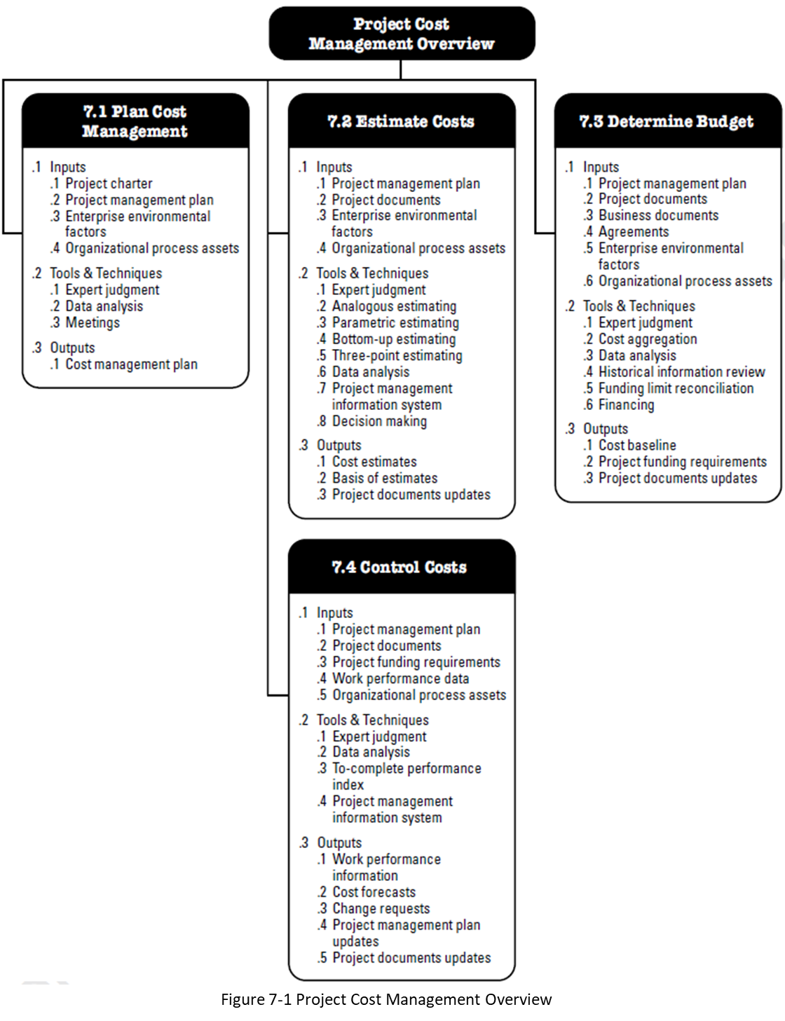
Determine Budget 7.3 in PMBOK
The process that creates a cost baseline (a budget)
Source: PMBOK 6th Edition, 2017

Slide 4
Determine Budget 7.3 in PMBOK
A process to capture the estimated costs of the activities within work packages including cost reserves to create a project budget (an approved cost baseline). Someone senior involved in the project had to “sign off” on the baseline – it might be the customer or the project sponsor.
Source: PMBOK 6th Edition, 2017

Slide 5
Creating a Project Budget
The budget is a plan that identifies the resources (including costs), goals and schedule that allows a firm to achieve those goals
WBS
Project Plan
Scheduling
Budgeting
Top-down
Bottom-up
Use of activity-based costing (ABC)
Other approaches & techniques
Connection to … Triple Constraints, Iron Triangle?
Notes:
Scope is managed via the WBS, time by a schedule, and cost by a budget.

Slide 6
Top-Down Budgeting
Top management establishes an overall budget at the start.
All successive levels of the budgeting process must make their estimates fit within the context of the overall budget.
Different functions or departments may compete for their piece of the budget pie.
Top management estimates are often quite accurate
Results in budgetary discipline at the work package level.
What does compete for Budget mean?
Notes:
Using top down budgeting, the project level budget would be split or allocated into budget for the major deliverables. If there were 4 major deliverables, each with a different owner, they would all be looking for more than enough of the budget to get their major deliverable done. They might be competing for their share of the total budget.

Slide 7
Bottom-Up Budgeting
Think of the bottom of a WBS
Begins with applying direct and indirect costs to work packages (including activities).
The sum of the total costs of all work packages to create an overall project budget.
Emphasizes need to create a detailed project plan.
Facilitates coordination between functional areas.
Allows top management a clear view for prioritization among project’s competing resources.
It reduces top management’s control of the budget process.
Time consuming.
Where would this work well?
Notes:
Bottom up works well if you have the time, the data and the resources to create one. It is more accurate than top down.

Slide 8
Estimating Projects: Preferred Approach
Make rough top-down estimates.
Develop the WBS
Make bottom-up estimates.
Develop schedules and budgets.
Reconcile differences between top-down and bottom-up estimates
What role do schedules play in developing our budget?
Notes:
In order to budget, we have to include activity costs (as well as other costs such as fixed costs on the project). Costs for an activity depend on their scheduling. Human resource costs frequently depend on things like calendar availability, which impacts the cost. Sequencing of activities can me a human resource can perform activity A, but have to wait for B to be performed by someone else, so they can perform C. But they are flying back and forth to perform these activities.

Slide 9
A Hybrid: Phase Estimating
Begin with a top-down estimate
Then refine estimates for phases of the project as it is implemented
A detailed estimate (probably bottom up) is developed for the immediate phase and a macro estimate is made for the entire project including the remaining phases of the project
example on next slide

Slide 10
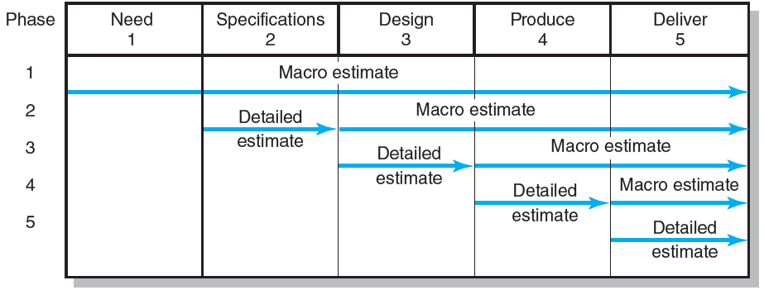
Phase Estimating over a Product Life Cycle
How accurate would the Phase 2 estimate be with this approach? The 2nd row of blue arrows?
Figure 5.3
The PMBOK calls planning where high level planning is done but more detailed planning is done as phases and activities details are getting closer – Rolling Wave Planning.
Notes:
Note, one could argue we are missing a detailed estimate for Phase 1 (Need). Our Macro Estimate in the Phase 1 doesn’t include this but in reality it would have.
But for Phase 2, we have finished Phase 1, so we are only estimating for 4 remaining phases, not 5. And we have gained some experience on how the project is going, and we’ve also had more time to gather requirements for the remaining phases. So because of these factors, the Phase 2 to 5 combined estimate will be more accurate than the macro estimate for Phases 2 to 5.

Slide 11
Activity-Based Costing (ABC)
“The use of traditional cost-allocation methods … may result in companies losing money on … projects … even though their accounting … may indicate a profitable transaction ...”
“This … occurs because the cost-tracking mechanism does not … recognize the cause-and-effect relationship … between indirect costs and direct costs.”
“ABC uses … activities that create cost [which] are called cost drivers. Once the drivers are identified, they can be used to estimate … cost.”
Retrieved from pmi.org: Activity-based costing does it warrant inclusion in a Guide to the project management body of knowledge?
Notes:
We have an expensive specialized truck that costs our small company $50K per year to own and operate. We perform customer projects that include labour, materials and the use of the truck. We average about 50 projects a year, so we assign $1K ($50K/50 projects = $1K/project) of overhead to each of our customer projects.
We just completed a project, and someone pointed out that the truck is used about 1,200 hours a year, but for this last customer project, we used it way more than average, 300 hours. The invoice to the customer was $12K, did we really make a profit on this project? We budgeted $4K of materials, $3K of labour and $2K of overhead (including $1K for the truck) for a cost budget of $9K.
We can think of this scenario in the context of the quote above “Cause-and-effect relationship … between indirect costs and direct costs”. The entire $50K cost of truck is not a direct cost in our last customer project. It is NOT used exclusively for our last project, so it’s not a direct cost. It’s used for multiple projects, so it’s an indirect cost. Overhead in general is an indirect cost. But how we allocate (but where is the real cause of the cost) overhead cost items (such as our expensive truck) can be important. We invoiced $12K in our last project, but if we used a cost driver of “hours that the truck is used”, we would assign 25% (300hrs/1200hrs) of the $50K to the last project, which would be $12.5K, and which alone exceeds our $12K invoice. We didn’t make a profit.

Slide 12
Activity-Based Costing (ABC)
Projects use activities & activities use resources
Assign costs to activities that use resources
Identify cost drivers associated with this activity
Compute a cost rate per cost driver unit or transaction
Multiply the cost driver rate times the volume of cost driver units used by the project (or activity within the project)

Slide 13
Another Activity-Based Costing (ABC) Example (Variable/Fixed)
Projects use activities & activities use resources
3 Minutes! Activity Based Costing Managerial Accounting Example (ABC Super Simplified) 2:50 minutes
https://www.youtube.com/watch?v=ivlI0HvUPQo

Slide 14
Activity-Based Costing (ABC) Example
A small piece of construction equipment is owned by a company and based on the hour meter on it, it is used 950 hours a year. The lease payment on the equipment is $2,200 per month, about, $3,500 of parts are bought per year, and about 25 hours of labour for maintenance and repair are performed each year on the equipment by an outside mechanic at $130/hr.
Project X wants to use this equipment for 120 hours on their project, what would be their cost for their project?
Projects use activities & activities use resources
Assign costs to activities that use resources
Identify cost drivers associated with this activity
Compute a cost rate per cost driver unit or transaction
Multiply the cost driver rate times the volume of cost driver units used by the project

Slide 15
Activity-Based Costing (ABC) Example
Assign Costs - yearly costs include: Lease 12 mon x $2,200/mon = $26,400 Parts = $3,500 Repair/Maintenance labour 25hrs x $130/hr = $3,250 Total = $33,150
Identify cost drivers - the equipment is typically used by the hour in a project
Compute a cost rate $33,150/950 hrs of use = $34.89/hr
Multiply the cost driver rate times the volume of cost driver units used by the project X 120 hrs x $34.89/hr = $4,186.80
Projects use activities & activities use resources
Assign costs to activities that use resources
Identify cost drivers associated with this activity
Compute a cost rate per cost driver unit or transaction
Multiply the cost driver rate times the volume of cost driver units used by the project

Slide 16
Time-Phased Budget Start with a Sample Project Budget with Direct and indirect (overhead) costs
This number feeds into the first row on the next slide
These are indirect costs
Table 8.6

Slide 17
Sample Budget Tracking Planned and Actual Activity Costs
What do negative variances mean, and how are they shown?
Note the word Budget is grayed out, as it is confusing, we mean Actual dollars spent
Table 8.7
Generally negative variances are “bad” (bad news), however the some source refer to being under budget as “bad” … why?
https://www.accountingcoach.com/blog/what-do-negative-variances-indicate
Notes:
Generally negative variances are “bad” (bad news) such as spending more money than was in the budget, a “bad” thing. E.g., we have a monthly cell phone budget of $50 per month, but our invoice was $62 so we overspent by $12, usually presented as -$12.00 or sometimes ($12.00) or sometimes $12,00 (in a red font). But you had 3 workers on your project, and your labour cost was lower than expected, it could be “bad” that the budget wasn’t completely spent – i.e. because it probably means you had less than 3 workers actually showing up to work on the project, and the project would end up being late.

Slide 18
Example of a Time-Phased Budget
A time phased budget when formally approved becomes the Cost Baseline, and aligns with a Schedule Baseline. Milestones on a schedule can also align with the cost budget.
Enter the row totals
Enter the cumulative numbers
Why do we have duplicate totals?
Table 8.8
Notes:
We total the cumulative total of the columns (the months) and compare it to the total of the sum of the Activities (the rows). We compare the two to ensure they are the same, that they “balance”. It’s easy to have errors that don’t balance, such as in large Excel workbooks.

Slide 19
A Time-Phased Budget is Based on Activity Predecessors Relationships
Activity | Predecessor Activities
Survey | -
Design | Survey
Clear Site | Survey
Foundation | Clear Site
Framing | Design, but also Foundation
Plumb and Wire | Design, but also Foundation
The activity Survey doesn’t have a predecessor, it can start immediately. This is the first Activity in the project.
Clear Site can only start after Survey is completed. We need to have the site surveyed to know exactly what area of land to clear.
Framing can only start when both the Design, and Foundation are complete. We cannot construct a frame until we have the Design (such as where the walls go) and a Foundation (something to build our frame on).

Slide 20
Time-Phased Budget with Predecessors Shown
Note, a time-phased budget distorts duration. Framing could have started April 3, and ended May 5, it might be a 5 week duration, NOT 2 months
Relationship arrows are typically NOT shown on time phased budgets
Table 8.8

Slide 21
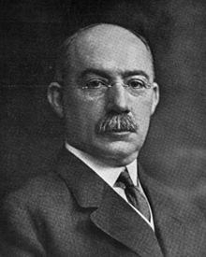
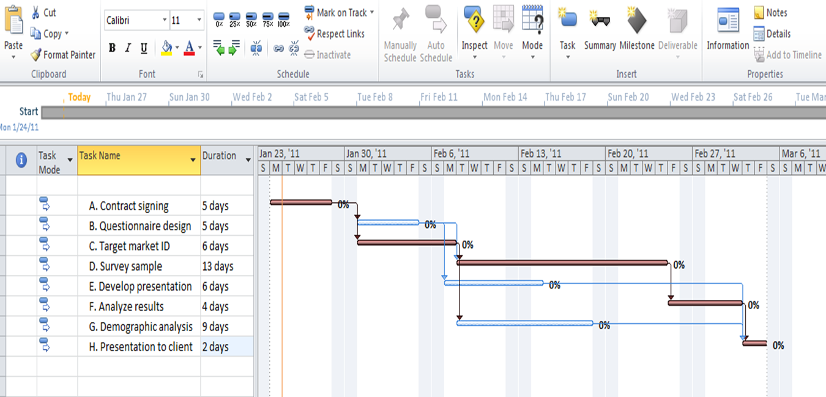
A Time Phased Budget is a form of a Crude Gantt Chart
Henry Gantt designed the chart now called the Gantt Chart circa 1910 to 1915
A graphical, calendar schedule showing the durations of tasks or activities (work). In this MS Project example the sequence of the work to be done is conveyed by the arrows.
Check the previous slide to see how the costs on the time phased budget can give a crude idea of what a Gantt Chart would look like.

Slide 22
A Time Phased Budget in Excel
Excel is frequently used to create time phased budgets. In this example above, only a few activity costs have been entered so far.
You will need to use these two files for your graded assignment. See FOL/Content/Course Assignments and open these two files and review them based on notes from the following slide.
Assignment Estimates & Time Phased EXAMPLE V1.xlsx
Assignment Estimates & Time Phased Student TEMPLATE V1.xlsx

Slide 23
Estimates & Time Phased Excel File
The 2 Excel workbook xlsx files have:
Estimation worksheets for activities
A time phased budget worksheet that uses data from the Estimation worksheets
An S-Curve graph based on data from the time phased budget
There are cells in the Estimation worksheets for rationale, which may required for some assignments
The Time-Phased Budget worksheet (vs the Estimation worksheets) are designed to be laid out in days and dollars. Remember, do not include costs over the weekends in your time-phased budget worksheet, typically none of your project work is being done on the weekend.
The Excel file will plot a project S-curve chart, ensure the chart is pulling data from the correct cells in the worksheet.
Review both the template xls and the example xls on FOL, the example has numerous comments with instruction

Slide 24
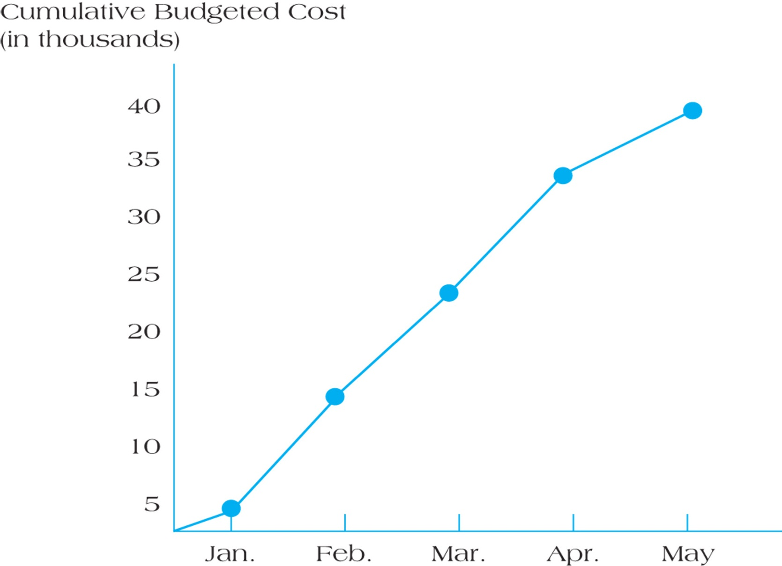
An S-Curve – Cumulative Budgeted Cost
Figure 8.7
This numbers on this chart are sourced from the cumulative row on the time phased budget a few slides back. See if they match.

Slide 25
Types of Contract Prices (PMBOK 6th Ed)
Fixed Price (lump-sum / turnkey) Contracts
Firm Fixed Price (FFP) contract
Fixed Price Incentive Fee (FPIF) contract
Fixed Price with Economic Price Adjustment (FPEPA) contract
Cost Plus Contract - Legitimate costs incurred plus a fee of sorts. Used if the scope is expected to change significantly.
Cost Plus Fixed Fee (CPFF)
Cost Plus Incentive Fee (CPIF)
Cost Plus Award Fee (CPAF)
Time & Materials (T&M) - sometimes called Time & Means or Time & Expenses – frequently used to acquire expertise or temporary staff where exact SOW’s cannot be created easily.
Combinations of these contract types are used - an FPIF contract could have incentive fees plus an economic price adjustment.

Slide 26
Fixed Price (lump-sum / turnkey) Contracts
Firm fixed price (FFP) contract
The price is agreed upon at the time of contract and typically only changes with scope changes
Fixed price incentive fee (FPIF) contract
Multiple incentive fees provide contract flexibility. Fees could depend on performance related to cost, the schedule, quality or other factors.
Frequently a price ceiling is used where costs that exceed the ceiling price are the responsibility of the supplier.
Fixed price with economic price adjustment (FPEPA) contract
The contract price is adjusted because of changes in costs due to inflation, currency changes, or other conditions.

Slide 27
Cost Plus Contracts
Cost Plus Fixed Fee (CPFF)
Reimbursed for legitimate costs plus a fee based as a percentage of the initial estimated costs.
Cost Plus Incentive Fee (CPIF)
Reimbursed for legitimate costs plus an incentive fee based on performance. Frequently a split is used to share any deviations from the original estimate.
With an 80/20 split (buyer:seller ratio), if the costs are over the estimate, the supplier only receives 80% of the overage. If the costs are less (underage), the supplier receives 20% of the savings.
Cost Plus Award Fee (CPAF)
Reimbursed for legitimate costs plus the majority of the fee is based on the buyer’s subjective assessment of performance meeting the award criteria.
A smaller fixed fee could be in addition to the award fee.

Slide 28
T&M, Combinations, Terms
Time & Materials (T&M, Time & Means, Time & Expenses)
Frequently used to acquire experts or temporary staff where exact SOW’s cannot be created easily.
Combinations of these contract types are used - an FPIF contract could have incentive fees plus an economic price adjustment.
Common Terms
Target Cost and Actual Cost
Target Price, Final Price
Target Incentive Fee, Final Fee, Maximum Fee, Minimum Fee
Target Cost + Target Fee = Target Price
Actual Cost + Final Fee = Final Price
Target Price – Target Cost = Target Fee

Slide 29
Firm Fixed Price (FFP) vs Cost Plus Fixed Fee (CPFF)
When a supplier calculates a budget for a customer project, this represents all the known costs for the project plus extra “reserve” funds for unknown costs. A fee (profit) is added to the costs which becomes the quote for the customer.
Example, a supplier estimates the cost and reserves for a project to be $1M, and they add 20% on top of the budget ($200K), for a fixed fee, which becomes a $1.2M quote for the customer.
If the customer and supplier agree to a FFP, then the contract price is $1.2M and the price is “fixed”, the customer pays $1.2M regardless of what the final actual costs are.
But if the customer and supplier agree to a simple CPFF, then the amount the customer pays depends on the final actual costs. If the final costs are $1.3M instead of the estimated $1M, the customer has to pay the $1.3M plus the $200K fee, or $1.5M. And if the final costs are less than estimated, say only $900K, then the customer only has to pay the $900K plus the $200K fee, or $1.1M.

Slide 30
Example, Cost Plus Incentive Fee (CPIF)
Example, a supplier estimates the cost and reserves for a project to be $1M (a target cost), and they add 30% on top of the budget ($300K), for a fee, which becomes a $1.3M quote for the buyer.
But if the buyer and supplier agree to a CPIF, then the amount the customer pays depends on the final actual costs. If the final actual costs are $1M which matches the target cost of $1M, then the buyer pays the $1.3M quoted cost, $1M for the cost, and $0.3M for the fee.
But if the actual cost is only $0.9M which is less than the target cost (a $100K underage), and the CPIF has a 80/20 split (buyer:seller ratio), the buyer benefits from 80% of the underage savings ($80K) and the supplier only receives 20% of the underage savings ($20K). The supplier receives $900K+$300K+$20K =$1,220K.
And if the actual cost is $1.1M which is more than the target cost (a $100K overage), the buyer only has to pay 80% of the overage ($80K) and the supplier has to pay 20% of the overage ($20K) $1,100K+300K-$20K= $1,380K.
Notes:
One way of remembering how the 80/20 split works (buyer:seller ratio), is to think of the latter half of the split, the seller “20”, as the % adjustment to what the buyer pays the supplier after the actual cost and fees are totaled. So in the example you can look at it as in both scenarios the supplier was paid the actual costs plus their fee, but if there was an underage they received a bonus fee of 20% of the underage, and if there was an overage, they had a “penalty” fee of 20% of the overage. Note, we can think of this as a penalty, but the supplier might not have done anything “wrong” per se.

Slide 31
Question #1 - A budget has been created for a project by a supplier. The budget for all costs has been determined to be $1,500,000 by the supplier -- this includes direct and indirect costs direct and indirect, contingency reserves and management reserve but not profit. The project has been quoted with an additional 15% for the suppliers fee (profit). After the project has been executed all actual costs totaled $1,600,000. Per the contract type, the customer pays the supplier $1,725,000. What type of contract is this?
Cost Plus Fixed Fee
Cost Plus Incentive Fee
Firm Fixed Price
Time & Materials

Slide 32
Question #1 - A budget has been created for a project by a supplier. The budget for all costs has been determined to be $1,500,000 by the supplier (this includes direct and indirect costs direct and indirect, contingencies and management reserve). The project has been quoted with an additional 15% for the suppliers fee (profit). After the project has been executed all actual costs totaled $1,600,000. Per the contract, the customer pays the supplier $1,725,000. What type of contract is this?
Cost Plus Fixed Fee
Cost Plus Incentive Fee
Firm Fixed Price
Time & Materials
Firm Fixed would be the estimated costs of $1500K plus a fee of 15% of the estimate costs ($225K) which totals $1725K. The actual costs are not relevant in a Firm Fixed Price contract.

Slide 33
Question #2 - Same scenario as previous question. A budget has been created for a project by a supplier. The budget for all costs has been determined to be $1,500,000 by the supplier (this includes direct and indirect costs direct and indirect, contingencies and management reserve). The project has been quoted with an additional 15% for the suppliers fee (profit). After the project has been executed all actual costs totaled $1,600,000. What should the customer be billed if it was a cost plus fixed fee CPFF contract?
$1,725,000
$1,840,000
$1,750,000
$1,825,000

Slide 34
Question #2 - Same scenario as previous question. A budget has been created for a project by a supplier. The budget for all costs has been determined to be $1,500,000 by the supplier (this includes direct and indirect costs direct and indirect, contingencies and management reserve). The project has been quoted with an additional 15% profit rate. After the project has been executed all actual costs totaled $1,600,000. What should the customer be billed if it was a cost plus fixed fee CPFF contract?
$1,725,000
$1,840,000
$1,750,000
$1,825,000
$1,825,000 = the fee (1,500,000 * 15% or $225K), plus actual costs $1,600K

Slide 35
Question #3 - A budget has been created for a project. The budget has been determined to be $1,500,000 (this includes costs (direct and indirect), contingencies and management reserve. The project has been priced as a CPFF contract with a fixed profit fee of $150,000. After the project has been executed all actual costs totaled $1,600,000. What should the customer be billed and what profit rate (divide the profit by your total actual costs) does the seller end up making?
$1,650,000 and 10%
$1,750,000 and 9.375%
$1,750,000 and 10%

Slide 36
Question #3 - A budget has been created for a project. The budget has been determined to be $1,500,000 (this includes costs (direct and indirect), contingencies and management reserve. The project has been priced as a CPFF contract with a fixed profit fee of $150,000. After the project has been executed all actual costs totaled $1,600,000. What should the customer be billed and what profit rate (divide the profit by your total costs) does the seller end up making?
$1,650,000 and 10%
$1,750,000 and 9.375%
$1,750,000 and 10%
A Cost Plus Fixed Fee would be $1600K plus fixed fee of $150K or $1750K. The profit for the seller would be their fee of $150K, but their actual costs were $1600 not $1500. So $150K/$1600K = 0.09375 or 9.375%

Slide 37
Question #4 - A budget has been created for a project. The budget has been determined to be $1,500,000 (this includes costs, both direct and indirect), contingencies and management reserve. The project has been priced as a CPFF contract with a fixed fee of 10%. After the project has been executed all actual costs totaled $1,600,000. What should the customer be billed?
$1,600,000
$1,650,000
$1,750,000
$1,760,000

Slide 38
Question #4 - A budget has been created for a project. The budget has been determined to be $1,500,000 (this includes costs (direct and indirect), contingencies and management reserve. The project has been priced as a CPFF contract with a fixed fee of 10%. After the project has been executed all actual costs totaled $1,600,000. What should the customer be billed?
$1,600,000
$1,650,000
$1,750,000
$1,760,000
The invoice to the customer for a Cost Plus Fixed Fee contract would be the same as the previous question. Although the fixed fee is 10% in this question rather than $150K in the previous question, the 10% is applied to the estimated costs of $1500K which would be $150K as per the previous question. We DO NOT apply the 10% to the actual costs of $1600K. The fixed fee is fixed before the contract starts, we wouldn’t even know the final actual costs.

Slide 39
Question #5 - A budget has been created for a project. The budget has been determined to be $1,500,000 (this includes costs (direct and indirect), contingencies and management reserve. The project has been priced as a Firm Fixed contract with a profit of 15% for the suppliers fee (profit). After the project has been executed all actual costs totaled $1,400,000. What should the customer be billed and what profit rate (divide the profit by your total costs) do they end up making?
$1,725,000 and 15%
$1,725,000 and 23.21%
$1,610,000 and 15%

Slide 40
Question #5 - A budget has been created for a project. The budget has been determined to be $1,500,000 (this includes costs (direct and indirect), contingencies and management reserve. The project has been priced as a Firm Fixed contract with a profit of 15% for the suppliers fee (profit). After the project has been executed all actual costs totaled $1,400,000. What should the customer be billed and what profit rate (divide the profit by your total costs) do they end up making?
$1,725,000 and 15%
$1,725,000 and 23.21%
$1,610,000 and 15%
An FFP would have been quoted at $1,500K plus $225K (15% of $1,500K) = $1,725K. Because it’s fixed fee, and the costs were only $1,400K the supplier’s actual profit would have ended up being $1,725 - $1,400 or $325K. $325K/$1,400 = 23.21%

Slide 41
Question #6 - A budget has been created for a project. The budget has been determined to be $1,500,000 (this includes costs (direct and indirect), contingencies and management reserve. The project has been priced as a CPIF (Cost Plus Incentive Fee) contract with a fee of 15% and an 80/20 split. There were no scope changes, but after the project has been executed all actual costs totaled $1,600,000. What should the customer be billed?
$1,780,000
$1,725K
$1,805K
$1,760,000
$1,905K

Slide 42
Question #6 - A budget has been created for a project. The budget has been determined to be $1,500,000 -- this includes costs (direct and indirect), contingencies and management reserve. The project has been priced as a CPIF (Cost Plus Incentive Fee) contract with a fee of 15% and an 80/20 split. There were no scope changes, but after the project has been executed all actual costs totaled $1,600,000. What should the customer be billed?
$1,780,000
$1,725K
$1,805K
$1,760,000
$1,905K
At the target cost of $1,500K the customer would also pay the $225K fee (15% of $1,500,000) for a total of $1,725K. But the costs went over by $100K ($1,600,000 - $1,500,000) and because there is an 80/20 incentive split, the supplier does not get to charge $100K more, the customer only has to pay $80K (80% of the $100K) more or $1,725K + $80K = $1,805K

Slide 43
Summary
Understand and discern the differences of the following budgeting approaches:
Top-Down Budgeting
Bottom Up Budgeting
A Hybrid: Phase Estimating
Perform calculations for Activity-Based Costing (ABC)
Understand a Time Phased Budget and how to complete one using Excel
Understand different contract types
Work with basic costs in different contract types

Slide 44
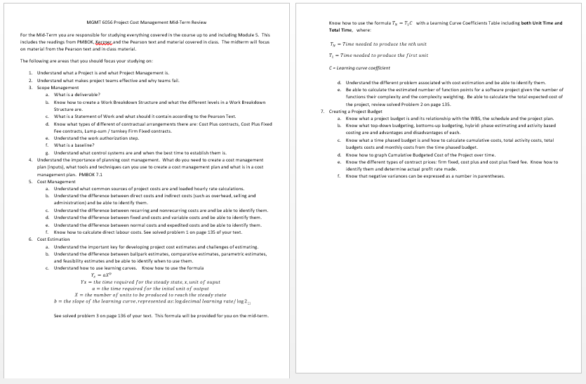
Homework
Refer to the Start Here section of this module
Study for Midterm Exam
Covers all modules up to the midterm exam module.
See the midterm exam review document in FOL, located in the Module called Midterm Exam
Read for the module after the midterm:
Kerzner 12th Ed 511-512, 11th 750-752
PMBOK 6th Ed 7.2.2.6
Review PPT files with solutions
Assignments, practice quizzes and graded quizzes, check the Course at a Glance and FOL/Content/Course Assignments & FOL/Evaluations/Quizzes

Slide 45
